Slide 1
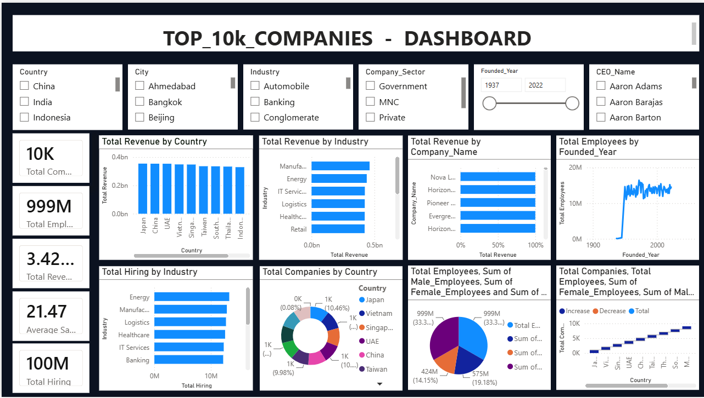
BUSINESS INTELLIGENCE REPORT
Top 10,000 Asia
Companies Dashboard
A Power BI analysis of workforce, compensation and hiring patterns across Asia's largest employers
10,000 COMPANIES
8 COUNTRIES
7 SECTORS

Slide 2
AT A GLANCE
Executive Summary
This report analyzes Power BI's Top 10,000 Asia Companies dashboard — a single-page, fully cross-filterable view of workforce scale, hiring, compensation and gender diversity across 8 countries and 7 technology-led sectors.
10,000
501.8M
24.6M
₹16.96L
78.2
COMPANIES
EMPLOYEES
HIRES (YR)
AVG SALARY
DIVERSITY
Report roadmap
01
Project & Dataset
02
Build Process
Scope, objectives and the 18-field source data
How raw data became a live Power BI dashboard
03
Workforce Analytics
04
Insights & Next Steps
Country, sector, salary and diversity breakdowns
What the numbers mean and where to take it next
TOP 10K ASIA COMPANIES
02

Slide 3



INTRODUCTION
Project Overview
Objective
10,000
Analyze the Top 10,000 companies across Asia using Power BI to uncover workforce size, hiring velocity, compensation and gender-diversity patterns — turning 18 raw data fields into a single interactive dashboard that supports executive decision-making.
COMPANIES ANALYZED
8
What the dashboard delivers
COUNTRIES COVERED
A single view of company scale, hiring and pay across 8 Asian markets
Cross-filterable KPIs for country, sector, company and founding year
A repeatable model for benchmarking future workforce data
7
INDUSTRY SECTORS
TOP 10K ASIA COMPANIES
03

Slide 4
DATA FOUNDATION
Dataset Overview
Key Fields
10,000
• Company_Name
• Annual_Salary_Cost_Cr
• Country / Region
• No_Of_Male / Female_Employees
ROWS · ONE PER COMPANY
• Sector
• Male / Female_Percentage
• No_Of_Employees
• Gender_Diversity_Score
18
• Last_Year_Hirings
• Company_Size_Category
• Hiring_Rate_Percent
• Salary_Band
COLUMNS · DATA FIELDS
• Avg_Salary_LPA
• Country / Sector Rank
Data quality: no missing values across the 10,000-row set; every company carries a complete workforce, pay and diversity profile.
TOP 10K ASIA COMPANIES
04

Slide 5





METHODOLOGY
Data Preparation Workflow
01
02
03
04
05
Import CSV
Clean Data
Transform
Create Measures
Build Dashboard
Load the 10,000-row source file into Power BI via Power Query.
Remove duplicates, fix types, and validate the 18 fields.
Reshape and categorize company size, salary band and region.
Build DAX measures for totals, rates and diversity scores.
Assemble KPI cards, charts, slicers into one interactive view.
TOP 10K ASIA COMPANIES
05

Slide 6



THE DELIVERABLE
Dashboard Preview
6 live KPI cards driven by DAX measures
6 synced slicers: country, city, industry, sector, year, CEO
9 visuals — bar, line, donut and waterfall charts
Full cross-highlighting between every visual
TOP 10K ASIA COMPANIES
06

Slide 7




HEADLINE METRICS
KPI Summary
10,000
501.8M
24.6M
₹16.96L
78.2
TOTAL COMPANIES
TOTAL EMPLOYEES
LAST-YEAR HIRINGS
AVG. SALARY (LPA)
AVG. DIVERSITY SCORE
Reading the numbers — workforce is broad-based (avg. ~50,000 employees per company) and hiring stayed strong at roughly 4.9% of the total workforce last year, with pay levels clustered tightly around ₹17 LPA across markets.
TOP 10K ASIA COMPANIES
07

Slide 8
WORKFORCE ANALYSIS
Employee Distribution by Country
KEY TAKEAWAY
A remarkably even spread
Workforce size ranges only from 61.1M in Japan to 66.1M in Vietnam — a spread of under 5M across all 8 markets. No single country dominates; hiring and operations are genuinely pan-Asian.
#1 Vietnam — 66.1M
#8 Japan — 61.1M
TOP 10K ASIA COMPANIES
08

Slide 9
SECTOR ANALYSIS
Workforce & Hiring by Sector
Workforce by Sector (M employees)
Hiring by Sector (M hires, last year)
TOP 10K ASIA COMPANIES
09

Slide 10
COMPENSATION ANALYSIS
Average Salary by Country
KEY TAKEAWAY
Pay is tightly clustered
Average salary varies by less than ₹1 LPA across all 8 countries — from ₹16.67 LPA in Indonesia to ₹17.45 LPA in Singapore — pointing to consistent, regionally-benchmarked pay structures.
TOP 10K ASIA COMPANIES
10

Slide 11

WORKFORCE COMPOSITION
Gender Diversity Overview
78.2 / 100
AVERAGE GENDER DIVERSITY SCORE
Computed across all 10,000 companies as a balance measure between male and female headcount.
Workforce split
Male employees
301.3M
60.0%
Female employees
200.5M
40.0%
TOP 10K ASIA COMPANIES
11

Slide 12
PORTFOLIO MIX
Company Size Distribution
KEY TAKEAWAY
Large firms dominate
Half the dataset (5,002 companies) falls into the Large category. Medium-sized firms add another 3,001, while Startups (501) and true Enterprises (8) sit at the tail ends of the scale.
TOP 10K ASIA COMPANIES
12

Slide 13

LEADERBOARD
Top Companies by Workforce
#
COMPANY
COUNTRY
SECTOR
EMPLOYEES
1
Tata Consultancy Services (TCS)
India
IT Services
600,000
2
Cognizant
India
IT Services
350,000
3
Infosys
India
IT Services
320,000
4
Accenture
India
IT Services
300,000
5
Wipro
India
IT Services
240,000
All five leading firms are India-based IT-services companies — reflecting the country's position as Asia's largest IT-services employment hub.
TOP 10K ASIA COMPANIES
13

Slide 14

UNDER THE HOOD
Power BI Capabilities Used
Power Query
DAX Measures
KPI Cards
ETL pipeline to import and reshape the raw CSV source.
Custom measures for totals, rates and diversity scoring.
Six live cards summarizing scale, pay and hiring at a glance.
Bar / Line / Donut Charts
Slicers
Cross-Highlighting
A mixed visual set matched to each analysis question.
Six synced filters: country, city, industry, sector, year, CEO.
Selecting any visual filters every other visual in real time.
TOP 10K ASIA COMPANIES
14

Slide 15


SO WHAT?
Business Insights & Recommendations
Workforce is genuinely pan-Asian
Diversity sits at a solid 78.2, with room to close
No single country holds more than 13% of total headcount — diversify supply-chain and hiring strategy across all 8 markets rather than over-indexing on one.
A 60/40 male-to-female split across 501M employees suggests targeted programs in the lower-scoring companies could lift the regional average further.
Pay is standardized, not a differentiator
Scale is concentrated in Large & Medium firms
With salaries within ₹1 LPA of each other region-wide, competitive advantage in talent will come from role scope and culture, not base pay alone.
80% of companies are Large or Medium — dashboard filters by Company_Size_Category can fast-track enterprise deal targeting.
TOP 10K ASIA COMPANIES
15

Slide 16
CONCLUSION
One dashboard,
endless strategic clarity
Thank
You
The Top 10K Asia Companies dashboard turns 10,000 rows and 18 fields into a scalable, user-friendly decision tool — ready to extend with forecasting, AI visuals and live connectivity as the next step.
Forecasting
Top 10K Asia Companies
Power BI Dashboard
AI Visuals
Live SQL Connectivity
Row-Level Security
TOP 10K ASIA COMPANIES
16

